Slide 1


Discussion #6
Wednesday, 10/05/2010
Multiplexing
HDLC Framing
Error Detection and Correction

Slide 2
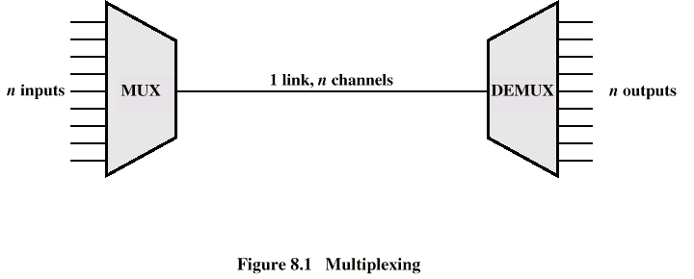
Ways of Multiplexing/Demultiplexing
Time Division Multiplexing (TDM)
You have n input lines coming in
The same # of lines going out..
Only one line interconnecting. How?

Slide 3
Packing the Data In
Multiplexing – A resource sharing process allowing information from several information sources to be aggregated onto a single high-speed link.
We are not limiting anyone's channel capacity
We are simply sending their signals through a shared line

Slide 4
Sharing – by time slots
Sample the Line 1 – Place its value in slot 1
Sampling the Line – and Send its value on its way
Line1
Line2
Line3
Slot1
Line4

Slide 5
More Time Slots
Line 2 Places its Sample on the Line
And it goes on…
Line1
Line2
Line3
Slot2|Slot1
Line4

Slide 6
Other Side - Demultiplexing
Similar to Multiplexing just the reverse
Line1
Line2
Slot2|Slot1
Line3
Line4
Line1
Line2
Slot2
Line3
Line4

Slide 7
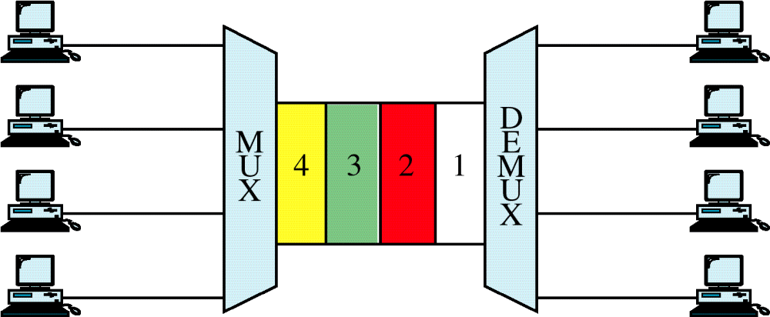
TDM
WCB/McGraw-Hill
© The McGraw-Hill Companies, Inc., 1998

Slide 8
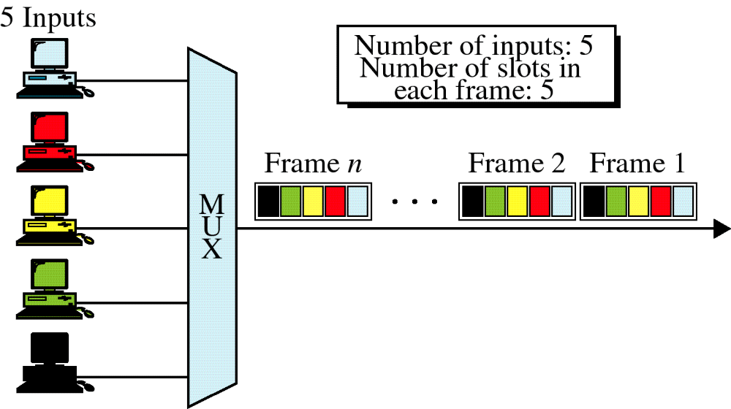
Synchronous TDM
WCB/McGraw-Hill
© The McGraw-Hill Companies, Inc., 1998

Slide 9
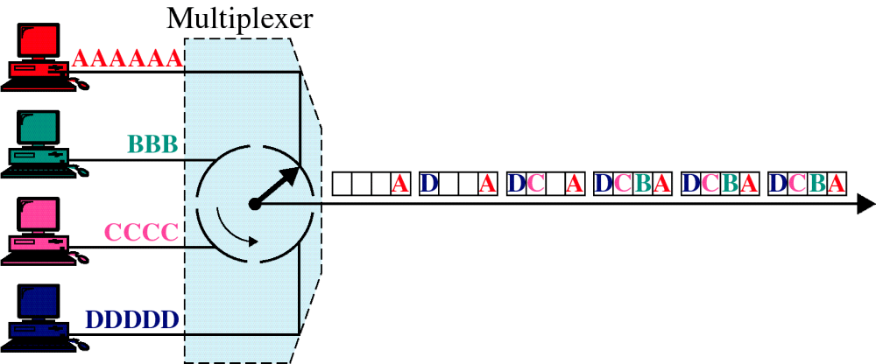
TDM - Multiplexing
WCB/McGraw-Hill
© The McGraw-Hill Companies, Inc., 1998

Slide 10
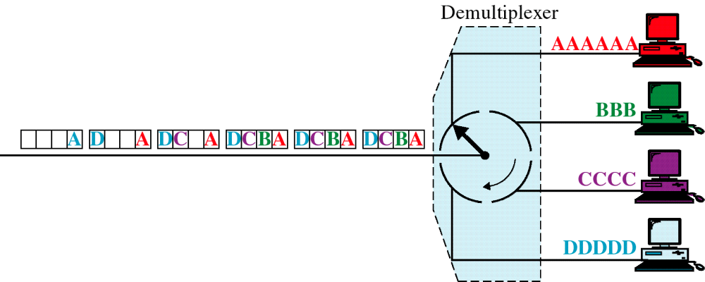
TDM - Demultiplexing
WCB/McGraw-Hill
© The McGraw-Hill Companies, Inc., 1998

Slide 11
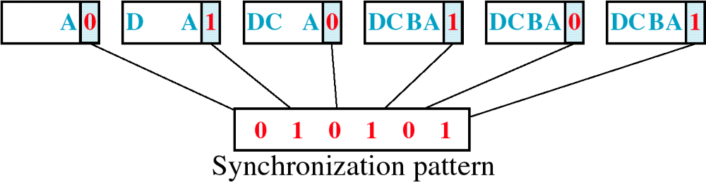
Framing Bits
WCB/McGraw-Hill
© The McGraw-Hill Companies, Inc., 1998

Slide 12
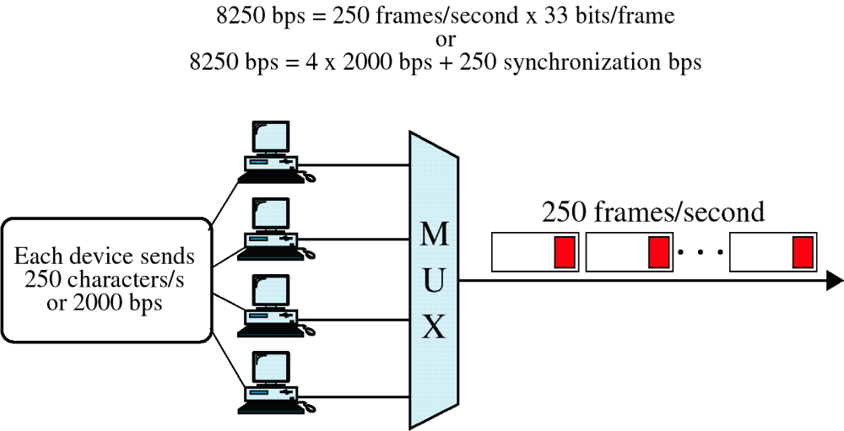
Data Rate
WCB/McGraw-Hill
© The McGraw-Hill Companies, Inc., 1998

Slide 13
TDM - Example
T-1 Lines
  Carries the equivalent of 24 voice lines
  Each analog voice line is sampled at 8000 times a second
  Digital Sample is thrown on the Digital Carrier Line
  On the other side Digital samples are used to reconstruct Analog Signal.

Slide 14
STDM (Asynchronous TDM)
How does it Work?
  Checks to see if there is data to transmit on input line
    If there is transmit data
    If not move on to next input line

Slide 15
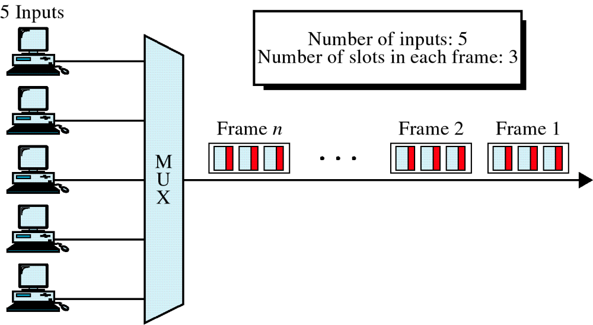
Asynchronous TDM
WCB/McGraw-Hill
© The McGraw-Hill Companies, Inc., 1998

Slide 16
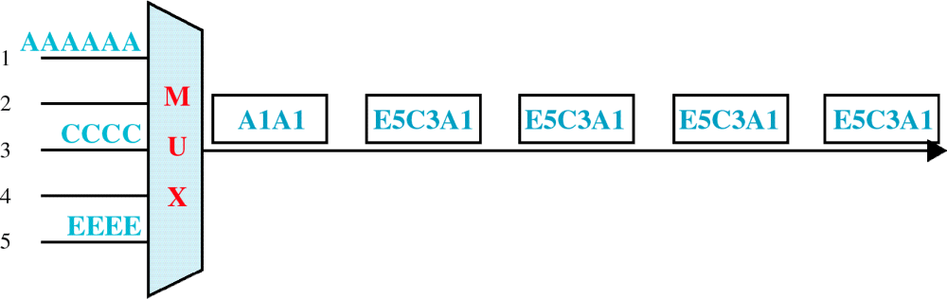
Frames and Addresses
a. Only three lines sending data
WCB/McGraw-Hill
© The McGraw-Hill Companies, Inc., 1998

Slide 17
TDM vs. STDM
Synchronous TDM – Gray Slots are actually carrying data
Slot 1
Slot 2
Slot 3
Slot 4
Slot 1
Slot 2
Slot 3
Statistical TDM – Uses empty time slots but does add some overhead
Slot 1
Slot 2
Slot 1
Slot 2
Slot 3
Slot 1

Slide 18
Notes on TDM
Sampling Occurs very quickly
Applicable to fixed number of flows
Requires Precise Timing
Resources are guaranteed

Slide 19
STDM
Statistical Time Division Multiplexing
Similar to regular TDM but different in this:
  Traffic is sent on demand – Only if there is data on line 1, will slot 1 be occupied by line 1
  Resources are not guaranteed
If we are no longer guaranteed a time slot why use it?
  We (the carrier) can take advantage of one of the input lines not being busy
Important distinction – STDM is used mainly for Digital Lines

Slide 20
TDM vs. STDM
Resources are guaranteed to the users
Sampling Occurs very quickly
Applicable to fixed number of flows
Requires Precise Timing
Wastes valuable carrier space
Traffic is sent on demand utilizing unused time slots so it benefits the Carrier
Resources are not guaranteed so when time slots are busy the users suffer
In real life there is some overhead
Speedup isn’t as obvious

Slide 21
Statistical TDM Parameters
  I = Number of Input Sources
  R = Data rate of each source (bps)
  α (Alpha) = mean fraction of time each source is transmitting
  M = Effective capacity of multiplexed line
  K = M / (I x R) = Ratio of multiplexed line capacity to total input rate
  λ (lambda) = α x I x R = Average Arrival time
  T_{s} = 1 / M = Service time in seconds

Slide 22
ρ : Line Utilization
ρ = Fraction of total link capacity being used
Many different forms to express line utilization
  ρ = λ T_{s}
  ρ = (α x I x R) / M
  ρ = α / K
  ρ = λ / M

Slide 23
Sample Problem #1
Ten 9600 bps lines are multiplexed using TDM. Ignoring overhead bits what is the total capacity required for Synchronous TDM?
  Simple: 10 X 9600 = 96 kbps (96,000)

Slide 24
Sample Problem #2
Ten 9600 bps lines are multiplexed using TDM. Assuming that we limit line utilization to 0.8 and each line is busy 50 % of the time. What is the capacity required for Statistical TDM?
  What do we know?
    Line utilization – ρ = .8
    Fraction of time transmitting - α = .5
    R Data Rate of each input source = 9600 bps
    I number of Input Sources = 10

Slide 25
Continued
The Equation:
ρ = α x I x R x /M
  Where M is the capacity of the multiplexed line
Rearrange for M
  M = α x I x R / ρ
Plug in the given parameters
  M = 0.5 x 10 x 9600 / 0.8
  M = 60 kbps

Slide 26
Sample Problem #3
Calculate the capacity of a Multiplexed carrier?
  24 voice channels multiplexed
  8000 samples per second
    Each frame lasts 1/8000 = 125 µ sec
  Uses 8 bit encoding per sample
  Capacity
    24 X 8000 samples/second X 8 bits/sample
    1,536,000 bits/second
  T-1 Adds an extra bit per frame (for synchronization) which makes it 1.544 Mbps

Slide 27
Sample Problem #4
What is the percent overhead on a T-1 Carrier?
  T-1 Carrier bandwidth of 1.544 Mbps
    Every 192 bits one more bit is added for framing.
  What is the overhead?

Slide 28

Continued
Overhead in a T-1 Line
  Every frame consists of 193 bits
  24 X 8 = 192 bits
  193-192 = 1 overhead bit
  1/193 = .5%

Slide 29
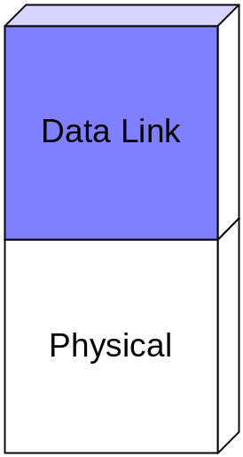
Layer 2 – The Data Link Layer
We are now going into more of a study of Layer 2 in the OSI layered architecture
We’ve talked about different kinds of Physical Layers
At this point we have a physical connection
How do we start sending data?

Slide 30
Framing
Problem: Breaking sequence of bits into a frame
Must determine first and last bit of the frame
Typically implemented by network adaptors
Adaptor fetches (deposits) frames out of (into) host memory

Slide 31
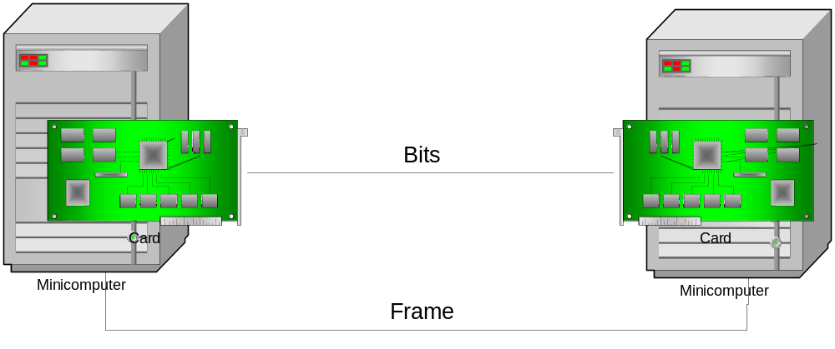
Framing (continued)

Slide 32
Bit-Oriented Protocols
HDLC: High-Level Data Link Control (also SDLC and PPP)
  bit-oriented synchronous data link layer protocol developed by the ISO.
  The original ISO standards for HDLC were:
    ISO 0009 — Frame Structure
    ISO 4335 — Elements of Procedure
    ISO 6159 — Unbalanced Classes of Procedure
    ISO 6256 — Balanced Classes of Procedure
  The current standard for HDLC is ISO 13239, which replaces all of those standards.
HDLC provides both connection-oriented and connectionless service.

Slide 33
High-level Data Link Control
HDLC can be used for
  Point to multipoint connections
  Currently used almost exclusively to connect one device to another, using what is known as Asynchronous Balanced Mode (ABM).
    It’s totally balanced i.e. no master/slave relationship.
    Each station may initialize, supervise, recover from errors, and send frames at any time.
  The other modes are Normal Response Mode and Asynchronous Response Mode.

Slide 34

HDLC Framing
HDLC frames are transmitted over links with no mechanism to mark the beginning or end of a frame.
Therefore, identifying the beginning and the end of each frame is done using a frame delimiter or flag
  Delimiter is a unique sequence of bits that is guaranteed not to be seen inside a frame, '01111110', or 7E in HEX.
When no frames are being transmitted on a synchronous link, a delimiter is continuously transmitted on the link.
  Using the NRZI encoding (0 bit = transition, 1 bit = no transition), this generates a continuous bit pattern, used by modems to train and synchronize their clocks.
Data
(variable length)
8
16
16
8
Beginning Sequence
Header
CRC
Ending Sequence
(optional)
HDLC Frame Structure

Slide 35
Bit Stuffing
On synchronous links, bit stuffing is used to guarantee, NO sequence of binary data appears to be a frame delimiter.
  The sending device ensures that any sequence of 5 contiguous 1-bits is automatically followed by a 0-bit.
  A simple digital circuit inserts a 0-bit after 5 1-bits.
  The receiving device knows this is being done, and will automatically strip out the extra 0-bits. At the receiver
    Should five consecutive 1s arrive, look at next bit(s):
      If next bit is a 0: remove it
      If next bits are 10: end-of-frame marker
      If next bits are 11: error
    So if a flag is received, it will have 6 contiguous 1-bits.
Assuming NRZI encoding, it also provides a minimum of one transition per 6 bit times, so the receiver can stay in sync with the transmitter.

Slide 36
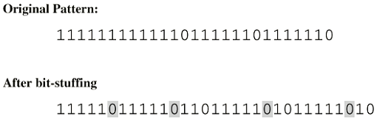
Example – Bit Stuffing

Slide 37


Error Detection and
Correction Using FCS
Frame Check Sequence (FCS) refers to the redundant information (Extra Checksum Characters) added to a Frame in a communication protocol for error detection and correction.
The sender computes a checksum on the entire frame and sends this along.
The receiver computes the checksum on the frame using the same algorithm, and compares it to the received FCS.
It can then detect whether any data was lost or altered in transit, discard the data, and request retransmission of the corrupted frame.
FCS is used in Ethernet, X.25, HDLC, Frame Relay, and other data link layer protocols.
A cyclic redundancy check (CRC) is often used to compute the FCS.
An Ethernet frame including the FCS terminating the frame

Slide 38

Cyclic Redundancy Check
Add K redundancy bits to N bits of data
  K << N
  e.g.: Ethernet Frame 12,000 bits – 32 bits Redundancy
Add k bits of redundant data to an n-bit message.
Represent n-bit message as an n-1 degree polynomial
e.g. MSG=10011010 corresponds to
M(x) = x ⁷+ x ⁴ + x ³ + x ¹ , n=8
Let k be the degree of some divisor polynomial G(x)
e.g. G(x) = x ³+ x ² + 1 (corresponds to 1101)
K=3

Slide 39

CRC - Continued
Instead of sending M(x), Transmit polynomial P(x) that is evenly divisible by G(x)
Receive polynomial P(x) + E(x)
If E(x)=0, it implies no bit errors happened.
Recipient divides (P(x) + E(x)) by G(x); the remainder will be zero only in two cases:
  Either E(x) was zero (i.e. there was no error)
  Or E(x) is exactly divisible by G(x).
Must choose G(x) to make the second case extremely rare.

Slide 40
Sender: Example
Sender wants to transmit MSG=10011010
MSG=10011010 , n=8 corresponds to M(x) = x ⁷+ x ⁴ + x ³ + x ¹
Divisor=1101 , k=3 corresponds to G(x) = x ³+ x ² + 1
Multiply M(x) by x ^{k}
In this example, we get:
M(x).x ³ = x ¹⁰ + x ⁷ + x ⁶ + x ⁴ =10011010000
Divide result by G(x) =1101 (Subtraction or addition is XOR in polynomial arithmetic)
The remainder is E(x) = x ² +1 = 101
Send P(x) = M(x).x ^{k} + E(x) which is exactly divisible by G(x)
i.e. Send 10011010000 + 101 = 10011010101, since this is
exactly divisible by G(x) =1101

Slide 41
Division
10011010000 = x¹⁰ + x⁷ + x⁶ + x⁴
1101 = x³ + x²+ 1
11111001
1101 |10011010000
1101
1001
1101
1000
1101
1011
1101
1100
1101
1000
1101
101 Remainder = x²+ 1

Slide 42
Example of CRC checking
Do the same example in Polynomial
10011010000 = x¹⁰ + x⁷ + x⁶ + x⁴
1101 = x³ + x³+ 1
x⁷ + x⁶ + x⁵ + x⁴ + x³ + 1 Quotient = 11111001
x³ + x²+ 1 |x¹⁰ + x⁷ + x⁶ + x⁴
x¹⁰ ⁺ x⁹ + x⁷
x⁹ + x⁶ + x⁴
x⁹ + x⁸ + x⁶
x⁸ + x⁴
x⁸ + x⁷ + x⁵
x⁷ + x⁵ + x⁴
x⁷ + x⁶ + x⁴
x⁶ + x⁵
x⁶ + x⁵ + x³
x³
x³ + x² + 1
x² + 1 Remainder = 101

Slide 43

Receiver
Divides the Received Polynomial by G(X)
  If the remainder is zero – No errors
  If not zero - Discard!
  What Kind of errors can we check?
  It depends on G(X)

Slide 44
Picking G(X)
Want to ensure that G(x) does not divide evenly into polynomial E(x).
All single-bit errors, as long as the x^{K} and x⁰ terms have non-zero coefficients.
All double-bit errors, as long as G(x) has a factor with at least three terms.
Any odd number of errors, as long as G(x) contains the factor (x + 1).
Any burst error (i.e sequence of consecutive error bits) for which the length of the burst is less than k bits.
Most burst errors of larger than k bits can also be detected.

